Slide 1
POLLUTION
ZUHA AHMAD
DS-670: Capstone: Big Data & Business Analytics
Dr. Jaume
15 February 2017

Slide 2
POLLUTION
COMPETITOR ARTICLE
SOURCE
Guozhen Tan, Wei Zhang, Hongwei Ge, Distributed algorithm for traffic data collection and data quality analysis based on wireless sensor networks, Department of Computer Science and Technology, Dalian University of Technology, Volume: 7 issue: 1, DOI: https://doi.org/10.1155/2011/717208

Slide 3
Novel Contribution
Air contamination sensors are gadgets that distinguish and screen the nearness of air contamination in the encompassing region.
They can be utilized for both indoor and open air situations. These sensors can be worked at home, or purchased from specific makes.

Slide 4
Air Quality Index
Air Quality Index (AQI) Values | Levels of Health Concern | Colors
When the AQI is in this range: | ..air quality conditions are: | ...as symbolized by this color:
0 to 50 | Good | Green
51 to 100 | Moderate | Yellow
101 to 150 | Unhealthy for Sensitive Groups | Orange
151 to 200 | Unhealthy | Red
201 to 300 | Very Unhealthy | Purple
301 to 500 |  | Maroon

Slide 5
AQI Concerns
Air Quality Index Levels of Health Concern | Numerical Value | Meaning
Good | 0 to 50 | Air quality is considered satisfactory, and air pollution poses little or no risk.
Moderate | 51 to 100 | Air quality is acceptable; however, for some pollutants there may be a moderate health concern for a very small number of people who are unusually sensitive to air pollution.
Unhealthy for Sensitive Groups | 101 to 150 | Members of sensitive groups may experience health effects. The general public is not likely to be affected.
Unhealthy | 151 to 200 | Everyone may begin to experience health effects; members of sensitive groups may experience more serious health effects.
Very Unhealthy | 201 to 300 | Health alert: everyone may experience more serious health effects.
Hazardous | 301 to 500 | Health warnings of emergency conditions. The entire population is more likely to be affected.

Slide 6
Data Collection
There are different sorts of air contamination sensors and the dominant part concentrates on five segments:
Ozone
Particulate matter
Carbon monoxide
Sulfur dioxide
Nitrous oxide
Sensors were exceptionally costly before, however with mechanical progressions sensors are turning out to be more reasonable and more across the board all through the populace.
They can help fill numerous needs and conveys consideration regarding ecological issues past the extent of the human eye.

Slide 7
Novel Contribution
EPA keeps up a storehouse of air quality information through the Air Quality System (AQS), where it stores information from more than 10,000 screens in the United States
While utilization of these sensors was costly previously, the 2010s saw a current pattern towards the improvement of less expensive convenient air-quality sensors that can be worn by people to screen nearby air quality levels.
These sensors help measure the spatio-worldly scope and assortment of concoction species, and engage people and groups to better comprehend their presentation surroundings and dangers from air contamination.

Slide 8
POLLUTION
An examination assemble drove by William Griswold at UCSD gave out convenient air contamination sensors to 16 suburbanites, and discovered "urban valleys" where structures caught contamination.
Gathering found that travelers in transports have higher exposures contrasted with those in autos.
Air contamination sensors can help individuals control their surroundings to a specific degree and increment familiarity with the poisons around them.
On the off chance that individuals are more mindful of the substance of nature, they can change their schedules and propensities with a specific end goal to be less affected via air contamination. This can help expand the personal satisfaction and general soundness of individuals at hazard.

Slide 9
Work By Competitors
The developing need of the continuous activity information has prodded the organization of expansive scale committed checking framework frameworks, which for the most part comprise of the utilization of inductive circle identifiers.
The circle sensor information is inclined to be noised or even missed under unforgiving environment.
The best in class remote sensor systems give an engaging and minimal effort contrasting option to inductive circles for activity observation.
Concentrating on the urban movement information accumulation, this paper proposes a dispersed calculation to gather the activity information in light of sensor systems and enhance the unwavering quality of information by quality examination.
Considering the specific connected attributes, this calculation firstly forms the information tests with an accumulation show in light of the mean channel, and afterward, the information quality is examined, and halfway awful information are repaired by the cusp calamity hypothesis.
The execution of this calculation is broke down with various reenactments in light of informational index acquire in urban roadway, and the near outcomes demonstrate that this calculation could get the better execution.

Slide 10
Data
Fig 1. Zepellin

Slide 11
Fig 2. Zepellin

Slide 12
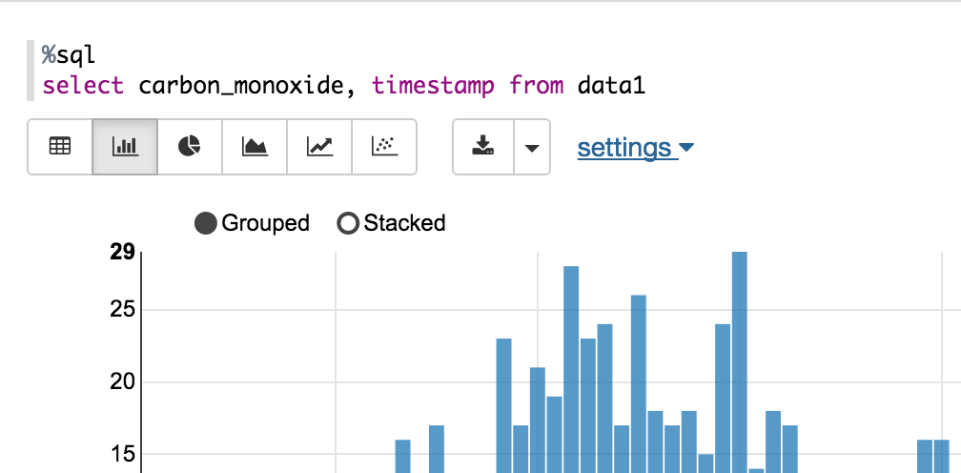
Fig 3. Zepellin

Slide 13
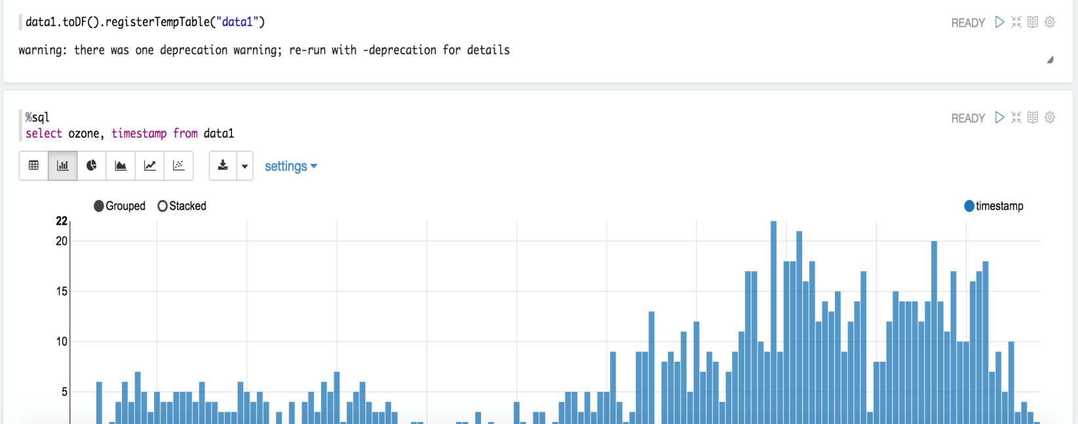
Fig 4. Zepellin

Slide 14
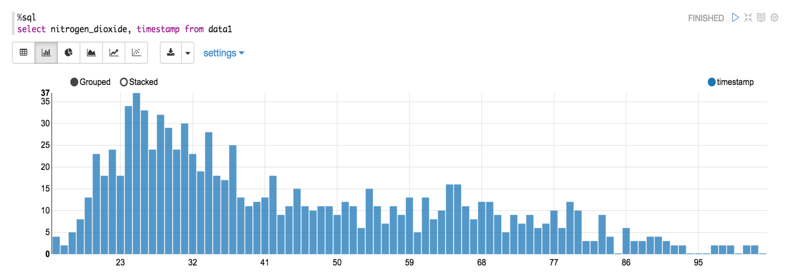
POLLUTION
Fig 4. Zeppelin

Slide 15
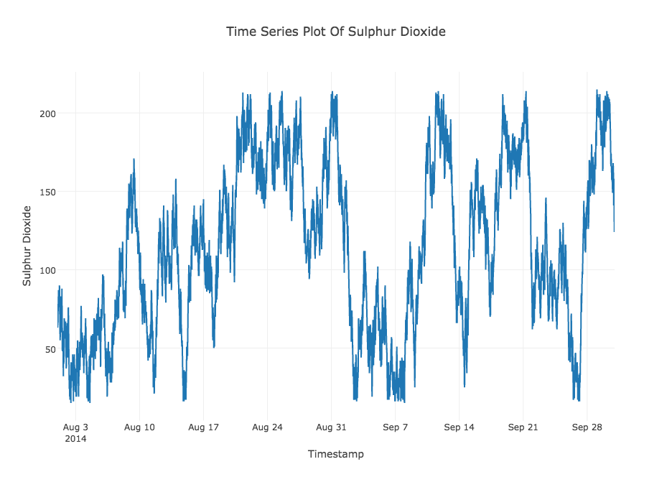
POLLUTION
Fig 4. Timestamp of Sulfur Dioxide

Slide 16
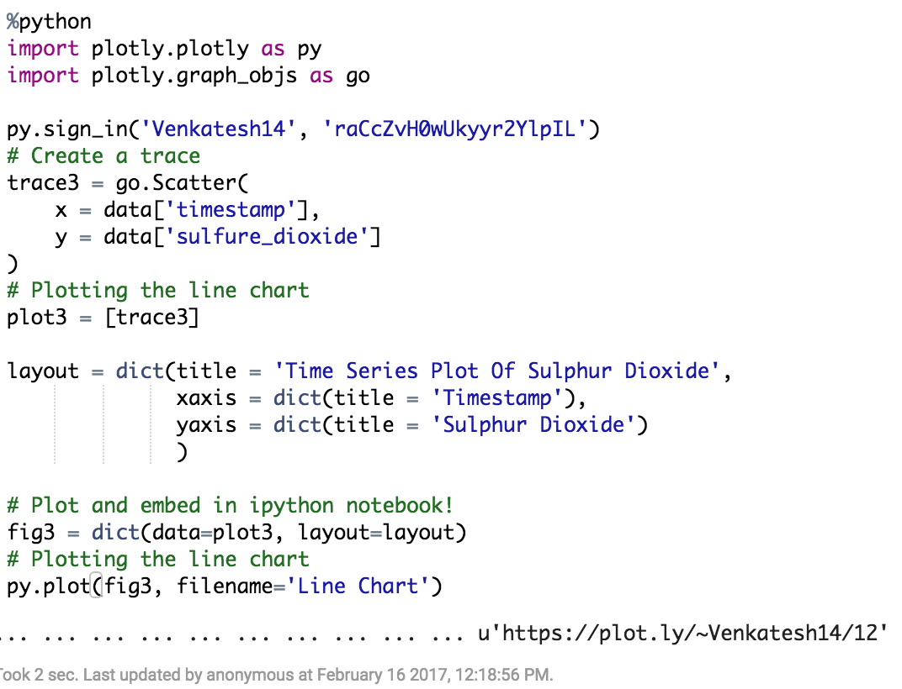

Slide 17
PSEUDO CODE
%python
import pandas as pd
import numpy as np
import matplotlib.pylab as plt
%matplotlib inline from matplotlib.pylab
import rcParams rcParams['figure.figsize'] = 15, 6
data = pd.read_csv('Users/ZAhnad/Downloads/pollution/*')
print data.head()

Slide 18
Methods
TIME SERIES
Have a characteristic transient requesting.
Sets aside a few minutes arrangement investigation
Unmistakable from cross-sectional reviews
Particular from spatial information examination where the perceptions ordinarily identify with land areas

Slide 19
POLLUTION
REGRESSION ANALYSIS
A factual procedure for assessing the connections among factors
Incorporates numerous systems for demonstrating and investigating a few factors, when the attention is on the relationship between a needy variable and at least one autonomous factors

Slide 20
POLLUTION
All the more particularly, relapse investigation helps one see how the run of the mill estimation of the needy variable changes when any of the autonomous factors is shifted, while the other free factors are held settled
Most regularly, relapse investigation assesses the contingent desire of the needy variable given the autonomous factors, that is, the normal estimation of the reliant variable when the free factors are settled
Less normally, the emphasis is on a quantile, or other area parameter of the restrictive dispersion of the needy variable given the free factors

